Slide 1




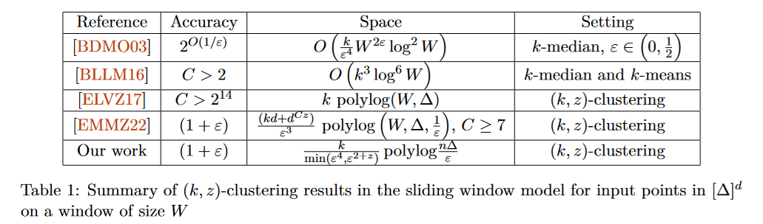
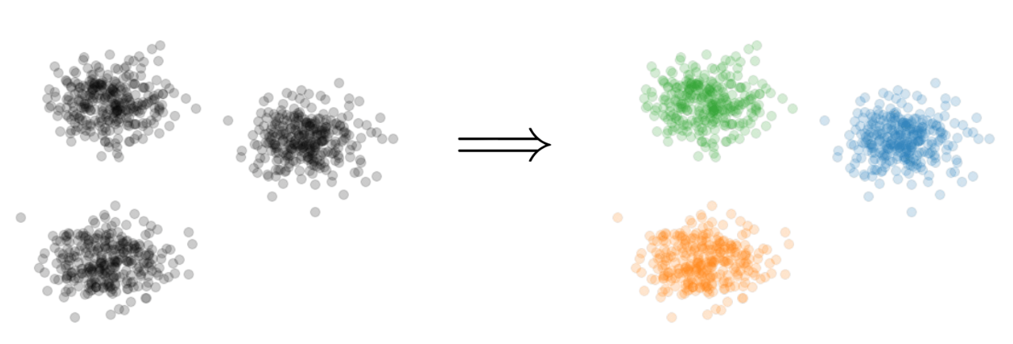
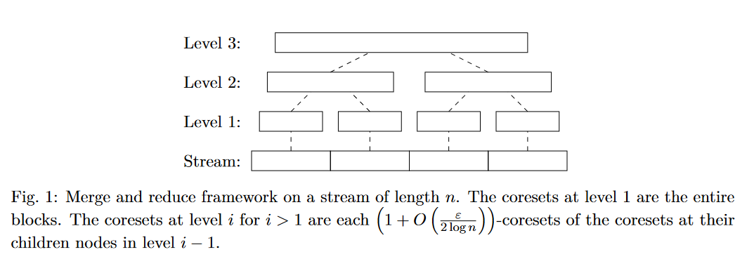
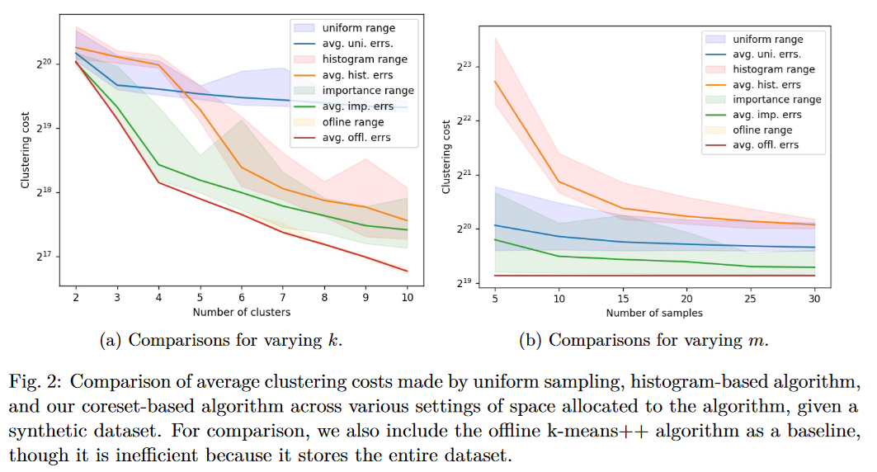


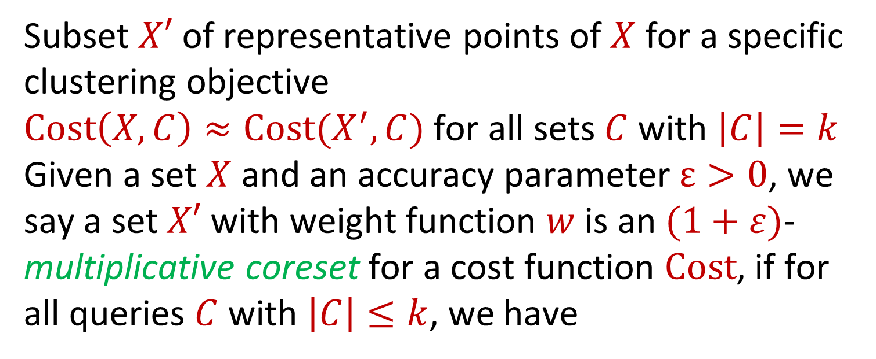

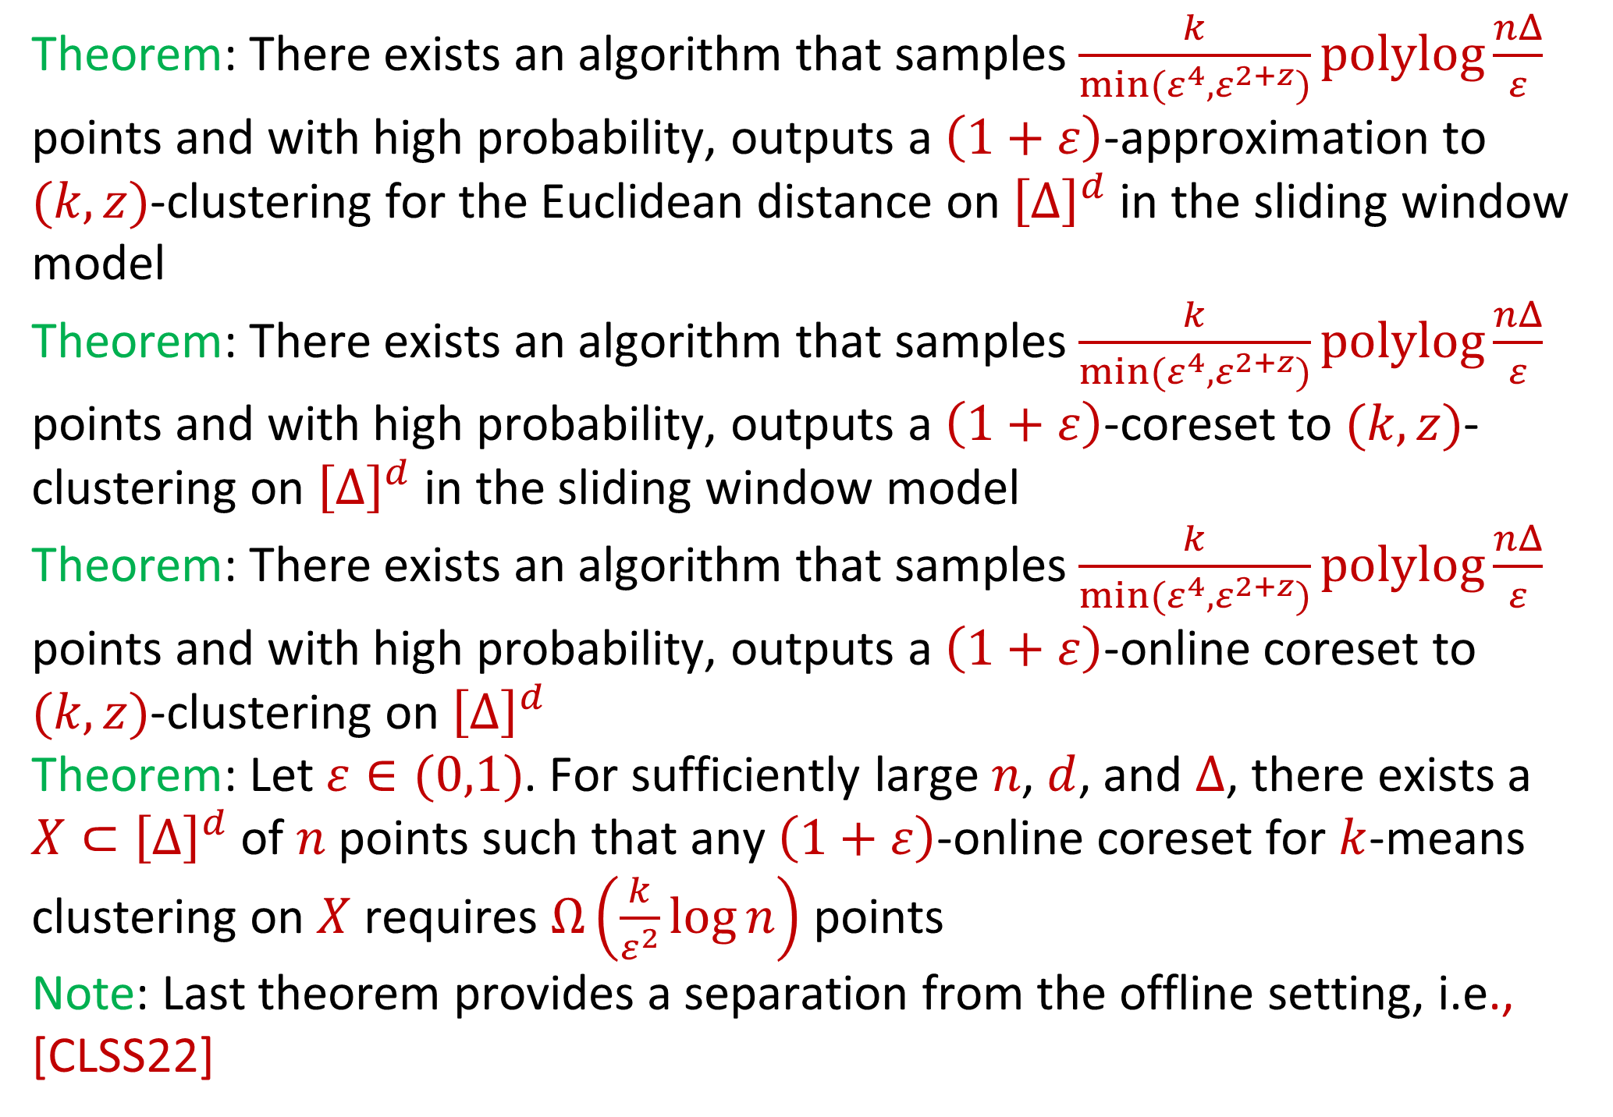

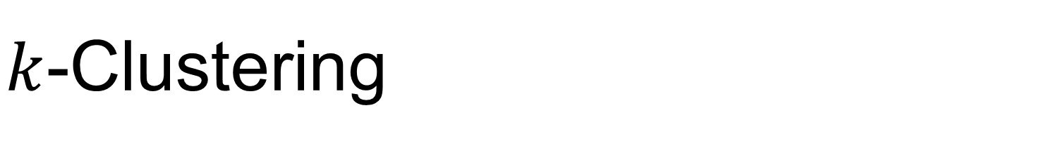
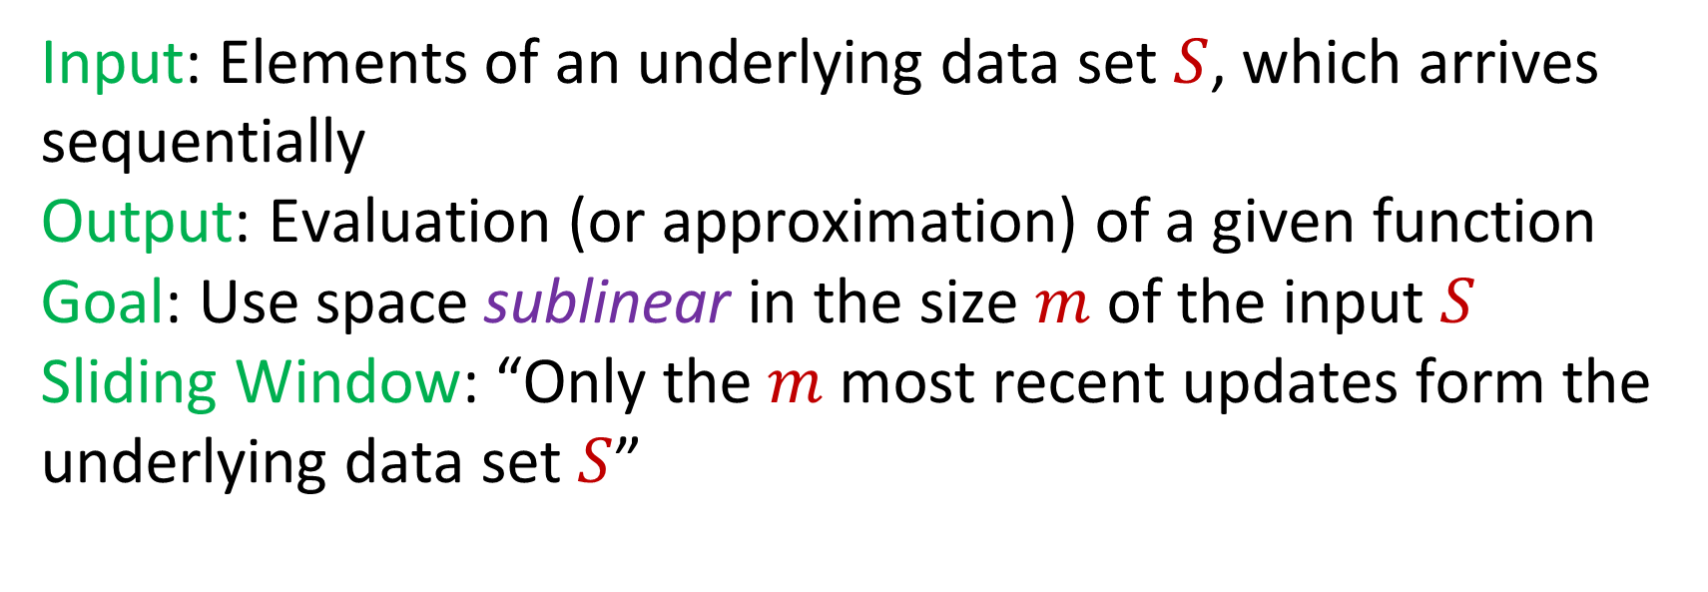


Near-Optimal $k$-Clustering in the Sliding Window Model
David P. Woodruff (Carnegie Mellon University)
Peilin Zhong (Google Research)
Samson Zhou (Texas A&M University)
$k$-Clustering
Related Literature
Coresets
Subset $X′$ of representative points of $X$ for a specific clustering objective
$Cost\left(X,C\right)≈Cost(X^{′},C)$ for all sets $C$ with $\left|C\right|=k$
Given a set $X$ and an accuracy parameter $ε>0$, we say a set $X′$ with weight function $w$is an $(1+ε)$-multiplicative coreset for a cost function $Cost$, if for all queries $C$ with $\left|C\right|≤k$, we have
Goal: Given input dataset $X$, partition $X$ so that “similar” points are in the same cluster and “different” points are in different clusters
There can be at most $k$ different clusters
$k$-median: $Cost\left(X,C\right)=\sum_{x∈X}{dist\left(x,C\right)}$
$k$-means: $Cost\left(X,C\right)=\sum_{x∈X}{{\left(dist\left(x,C\right)\right)}^{2}}$
$(k,z)$-clustering: $Cost\left(X,C\right)=\sum_{x∈X}{{\left(dist\left(x,C\right)\right)}^{z}}$
Goal: Find a set $C$ of $k$ centers that achieves a $\left(1+ε\right)$-approximation to
Our Results
$$\left(1−ε\right)Cost(X,C)≤Cost(X′,C,w)≤\left(1+ε\right)Cost(X,C)$$
$$k=3$$
Theorem: There exists an algorithm that samples $\frac{k}{min(ε^{4},ε^{2+z})}polylog\frac{nΔ}{ε}$ points and with high probability, outputs a $\left(1+ε\right)$-approximation to $(k,z)$-clustering for the Euclidean distance on ${\left[Δ\right]}^{d}$ in the sliding window model
Theorem: There exists an algorithm that samples $\frac{k}{min(ε^{4},ε^{2+z})}polylog\frac{nΔ}{ε}$ points and with high probability, outputs a $\left(1+ε\right)$-coreset to $(k,z)$-clustering on ${\left[Δ\right]}^{d}$ in the sliding window model
Theorem: There exists an algorithm that samples $\frac{k}{min(ε^{4},ε^{2+z})}polylog\frac{nΔ}{ε}$ points and with high probability, outputs a $\left(1+ε\right)$-online coreset to $(k,z)$-clustering on ${\left[Δ\right]}^{d}$
Theorem: Let $ε∈(0,1)$. For sufficiently large $n$, $d$, and $Δ$, there exists a $X⊂{\left[Δ\right]}^{d}$ of $n$ points such that any $\left(1+ε\right)$-online coreset for $k$-means clustering on $X$ requires $Ω\left(\frac{k}{ε^{2}}\log{n}\right)$ points
Note: Last theorem provides a separation from the offline setting, i.e., [CLSS22]
Intuition
$${\left(⋅\right)}^{z}$$
$${\left(⋅\right)}^{z}$$
$${\left(⋅\right)}^{z}$$
Online Coreset: Data structure that not only approximately preserves the cost of the data stream, but also the costs of all prefixes of the data stream
We show there exists an online coreset using the Meyerson sketch [Mey01] and an independent sampling version of known coresets, e.g., [CLSS22]
Run the online coreset in reverse at each time
$${\left(⋅\right)}^{z}$$
$$\min_{C:\left|C\right|≤k} Cost\left(X,C\right)=\min_{C:\left|C\right|≤k}{Σ_{x∈X}\left(dist\left(x,C\right)\right)}^{z}$$
Empirical Evaluations
Sliding Window Model
References
Input: Elements of an underlying data set $S$, which arrives sequentially
Output: Evaluation (or approximation) of a given function
Goal: Use space sublinear in the size $m$of the input $S$
Sliding Window: “Only the $m$ most recent updates form the underlying data set $S$”
[Mey01] Adam Meyerson. Online facility location. FOCS 2001
[CLSS22] Vincent Cohen-Addad, Kasper Green Larsen, David Saulpic, and Chris Schwiegelshohn. Towards optimal lower bounds for k-median and k-means coresets. STOC 2022
[BDMO03] Brian Babcock, Mayur Datar, Rajeev Motwani, and Liadan O’Callaghan. Maintaining variance and k-medians over data stream windows. PODS 2003
[BLLM16] Vladimir Braverman, Harry Lang, Keith Levin, and Morteza Monemizadeh. Clustering problems on sliding windows. SODA 2016
[ELVZ17] Alessandro Epasto, Silvio Lattanzi, Sergei Vassilvitskii, and Morteza Zadimoghaddam.
Submodular optimization over sliding windows. WWW 2017
[EMMZ22] Alessandro Epasto, Mohammad Mahdian, Vahab S. Mirrokni, and Peilin Zhong. Improved sliding window algorithms for clustering and coverage via bucketing-based sketches. SODA 2022
1 0 1 1 1 0 0 1 1 0

